Slide 1


Introduction to MapReduce
Data-Intensive Information Processing Applications ― Session #1
Jimmy Lin
University of Maryland
Tuesday, January 26, 2010
This work is licensed under a Creative Commons Attribution-Noncommercial-Share Alike 3.0 United States See http://creativecommons.org/licenses/by-nc-sa/3.0/us/ for details

Slide 2
What is this course about?
Data-intensive information processing
Large-data (“web-scale”) problems
Focus on applications
MapReduce… and beyond

Slide 3

What is MapReduce?
Programming model for expressing distributed computations at a massive scale
Execution framework for organizing and performing such computations
Open-source implementation called Hadoop

Slide 4
Why large data?

Slide 5
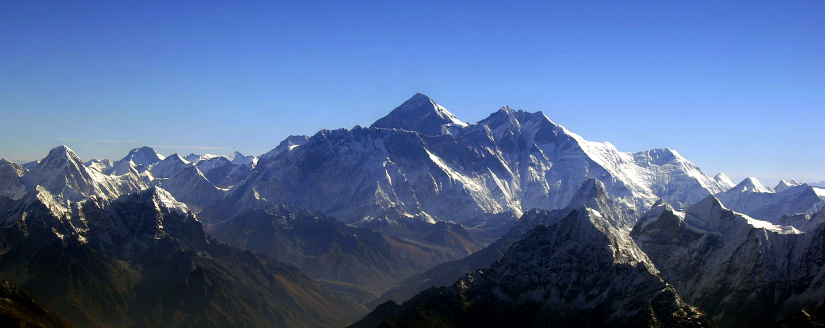
Source: Wikipedia (Everest)

Slide 6

How much data?
Google processes 20 PB a day (2008)
Wayback Machine has 3 PB + 100 TB/month (3/2009)
Facebook has 2.5 PB of user data + 15 TB/day (4/2009)
eBay has 6.5 PB of user data + 50 TB/day (5/2009)
CERN’s LHC will generate 15 PB a year (??)
640K ought to be enough for anybody.

Slide 7
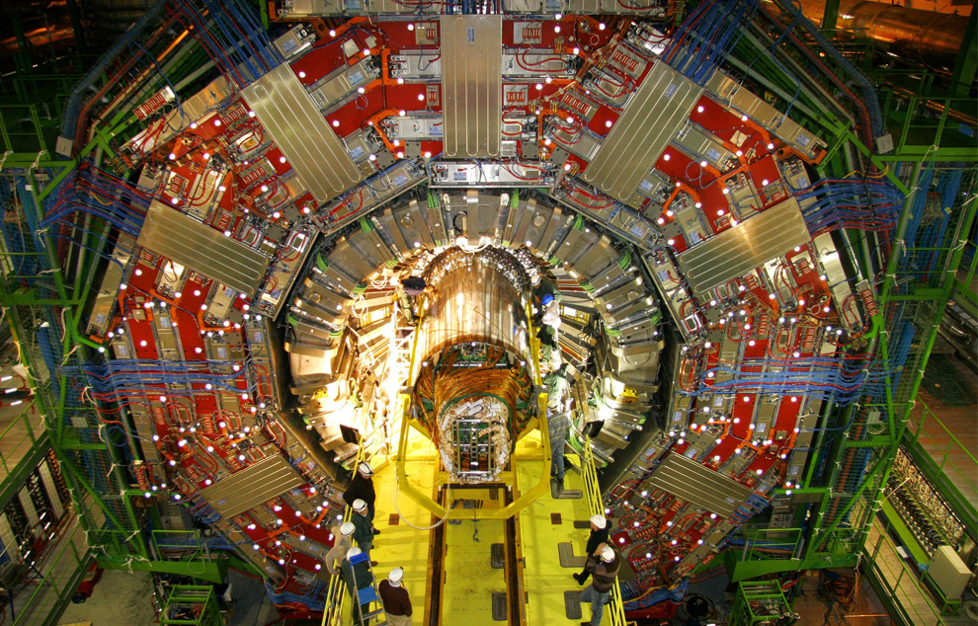
Maximilien Brice, © CERN

Slide 8
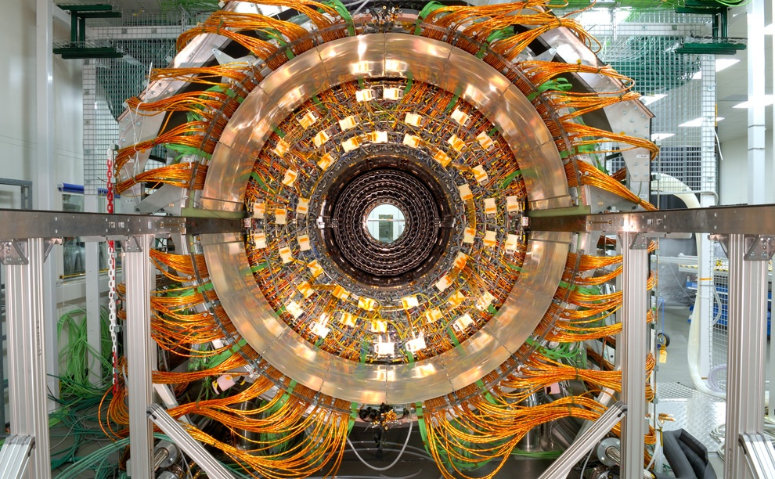
Maximilien Brice, © CERN

Slide 9
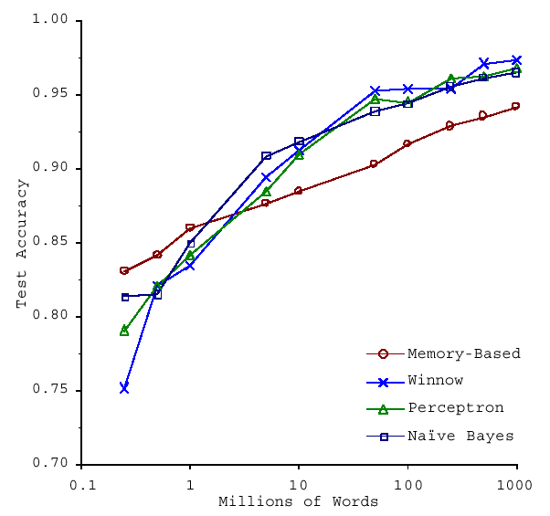
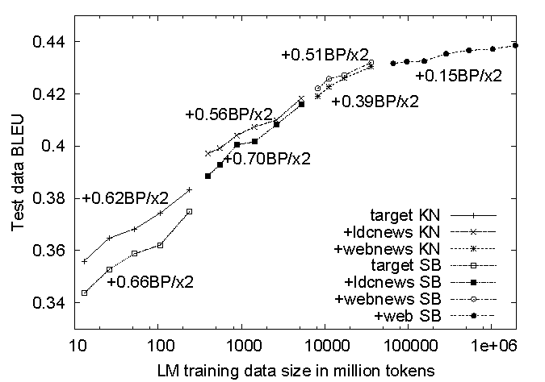
No data like more data!
s/knowledge/data/g;
How do we get here if we’re not Google?
(Banko and Brill, ACL 2001)
(Brants et al., EMNLP 2007)

Slide 10
What to do with more data?
Answering factoid questions
Pattern matching on the Web
Works amazingly well
Learning relations
Start with seed instances
Search for patterns on the Web
Using patterns to find more instances
Who shot Abraham Lincoln? → X shot Abraham Lincoln
Wolfgang Amadeus Mozart (1756 - 1791)
Einstein was born in 1879
Birthday-of(Mozart, 1756)
Birthday-of(Einstein, 1879)
PERSON (DATE –
PERSON was born in DATE
(Brill et al., TREC 2001; Lin, ACM TOIS 2007)
(Agichtein and Gravano, DL 2000; Ravichandran and Hovy, ACL 2002; … )

Slide 11

What is cloud computing?

Slide 12
The best thing since sliced bread?
Before clouds…
Grids
Vector supercomputers
…
Cloud computing means many different things:
Large-data processing
Rebranding of web 2.0
Utility computing
Everything as a service

Slide 13
Rebranding of web 2.0
Rich, interactive web applications
Clouds refer to the servers that run them
AJAX as the de facto standard (for better or worse)
Examples: Facebook, YouTube, Gmail, …
“The network is the computer”: take two
User data is stored “in the clouds”
Rise of the netbook, smartphones, etc.
Browser is the OS

Slide 14
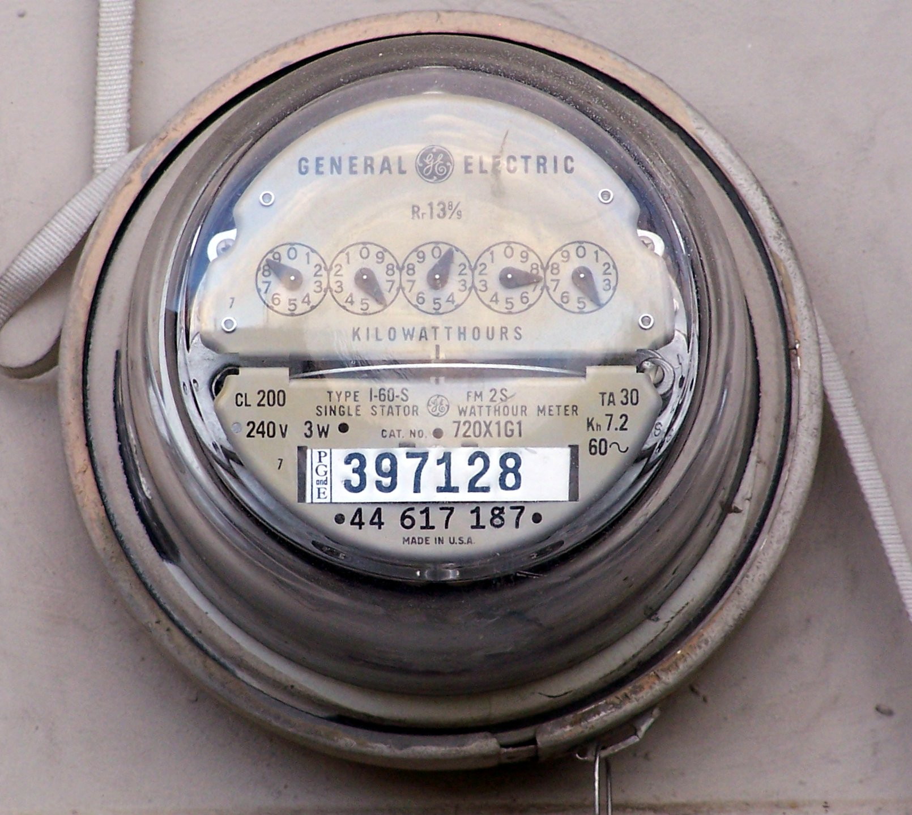
Source: Wikipedia (Electricity meter)

Slide 15
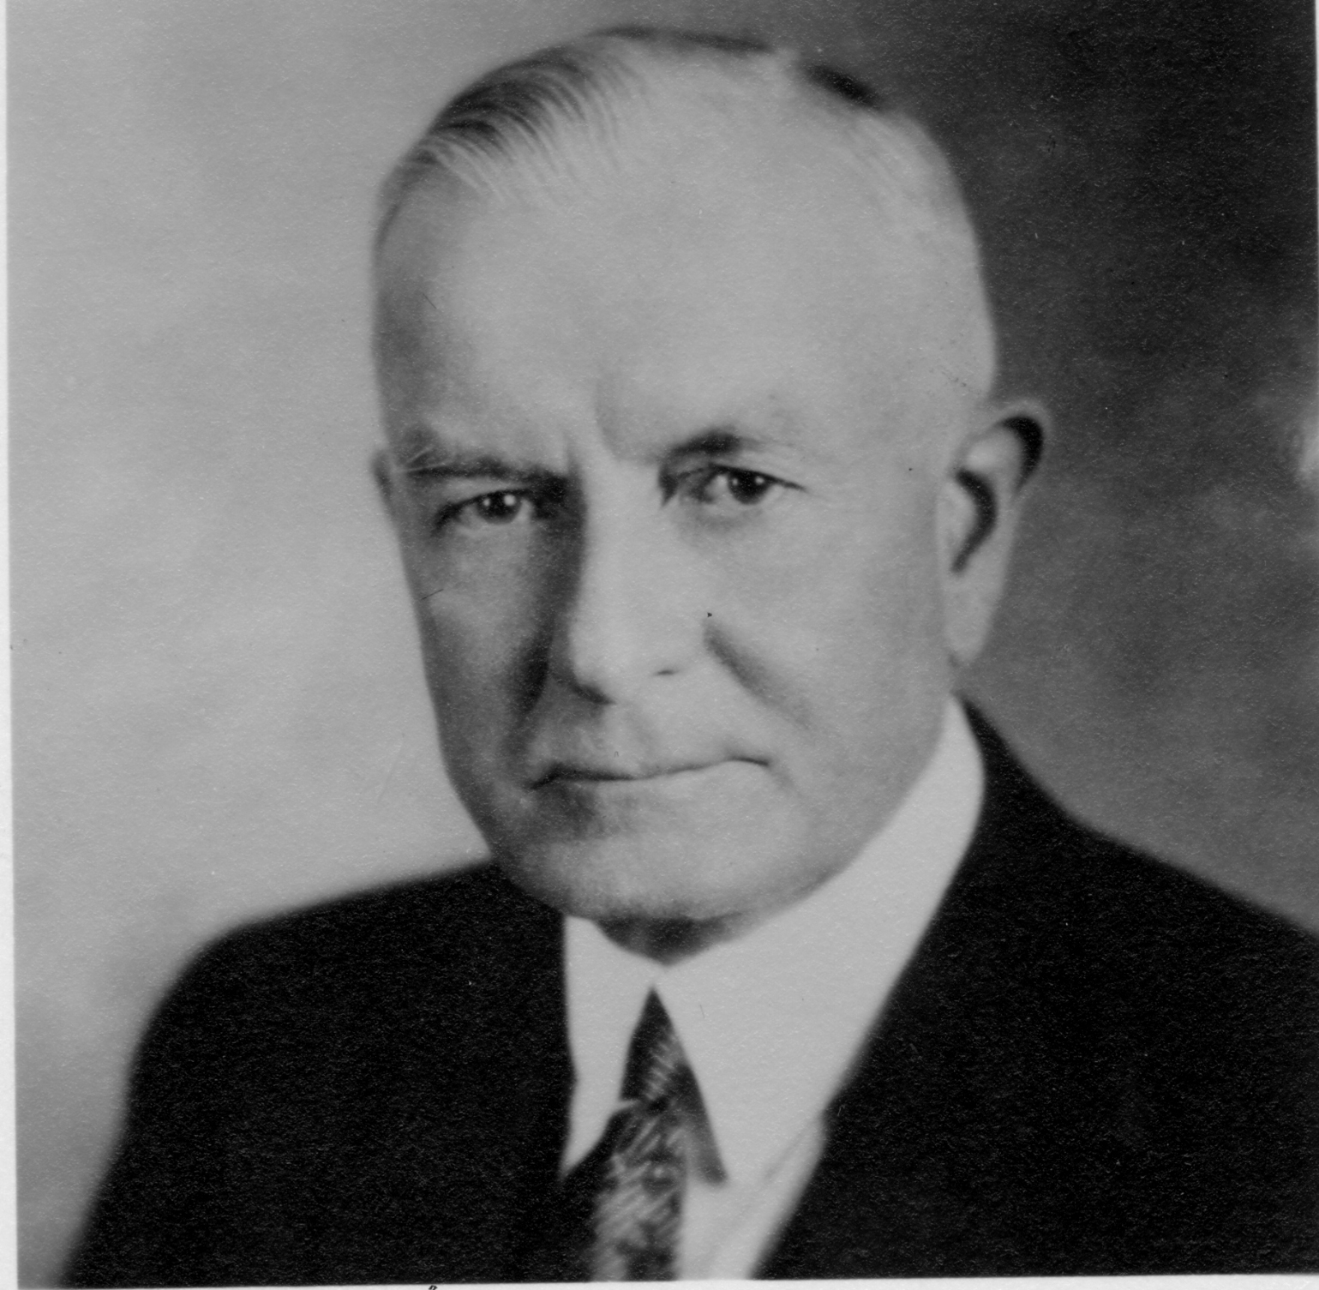
Utility Computing
What?
Computing resources as a metered service (“pay as you go”)
Ability to dynamically provision virtual machines
Why?
Cost: capital vs. operating expenses
Scalability: “infinite” capacity
Elasticity: scale up or down on demand
Does it make sense?
Benefits to cloud users
Business case for cloud providers
I think there is a world market for about five computers.

Slide 16
Enabling Technology: Virtualization
App
App
App
App
App
App
OS
OS
OS
Operating System
Hypervisor
Hardware
Hardware
Traditional Stack
Virtualized Stack

Slide 17
Everything as a Service
Utility computing = Infrastructure as a Service (IaaS)
Why buy machines when you can rent cycles?
Examples: Amazon’s EC2, Rackspace
Platform as a Service (PaaS)
Give me nice API and take care of the maintenance, upgrades, …
Example: Google App Engine
Software as a Service (SaaS)
Just run it for me!
Example: Gmail, Salesforce

Slide 18
Who cares?
Ready-made large-data problems
Lots of user-generated content
Even more user behavior data
Examples: Facebook friend suggestions, Google ad placement
Business intelligence: gather everything in a data warehouse and run analytics to generate insight
Utility computing
Provision Hadoop clusters on-demand in the cloud
Lower barrier to entry for tackling large-data problem
Commoditization and democratization of large-data capabilities

Slide 19
Course Administrivia

Slide 20
Course Pre-requisites
Strong Java programming
But this course is not about programming: we’ll expect you to pick up Hadoop (quickly) along the way
Focus on “thinking at scale” and algorithm design
Solid knowledge of
Probability and statistics
Computer architecture
No previous experience necessary in
MapReduce
Parallel and distributed programming

Slide 21
This course is not for you…
If you’re not genuinely interested in the topic
If you can’t put in the time
If you’re not ready to do a lot of work
If you’re not open to thinking about computing in new ways
If you can’t cope with the uncertainty, unpredictability, etc. that comes with bleeding edge software
Otherwise, this will be a richly rewarding course!

Slide 22
Course components
Textbooks
Components of the final grade:
Assignments (important, but not worth much)
Midterm and final exams
Final project (of your choice, in groups of ~3)
Class participation
I am unlikely to accept the following excuses:
“Too busy”
“It took longer than I thought it would take”
“It was harder than I initially thought”
“My dog ate my homework” and modern variants thereof

Slide 23
Cloud Resources
Hadoop on your local machine
Hadoop in a virtual machine on your local machine
Hadoop in the clouds with Amazon EC2
Hadoop on the Google/IBM cluster

Slide 24
Important Aside
Usage agreement for EC2
Usage agreement for Google/IBM cluster
Stay tuned for more details over email…

Slide 25

Source: Wikipedia (Japanese rock garden)

Slide 26
Hadoop Zen
This is bleeding edge technology (= immature!)
Bugs, undocumented features, inexplicable behavior
Data loss(!)
Don’t get frustrated (take a deep breath)…
Those W$*#T@F! moments
Be patient…
We will inevitably encounter “situations” along the way
Be flexible…
We will have to be creative in workarounds
Be constructive…
Tell me how I can make everyone’s experience better

Slide 27
How do we scale up?

Slide 28
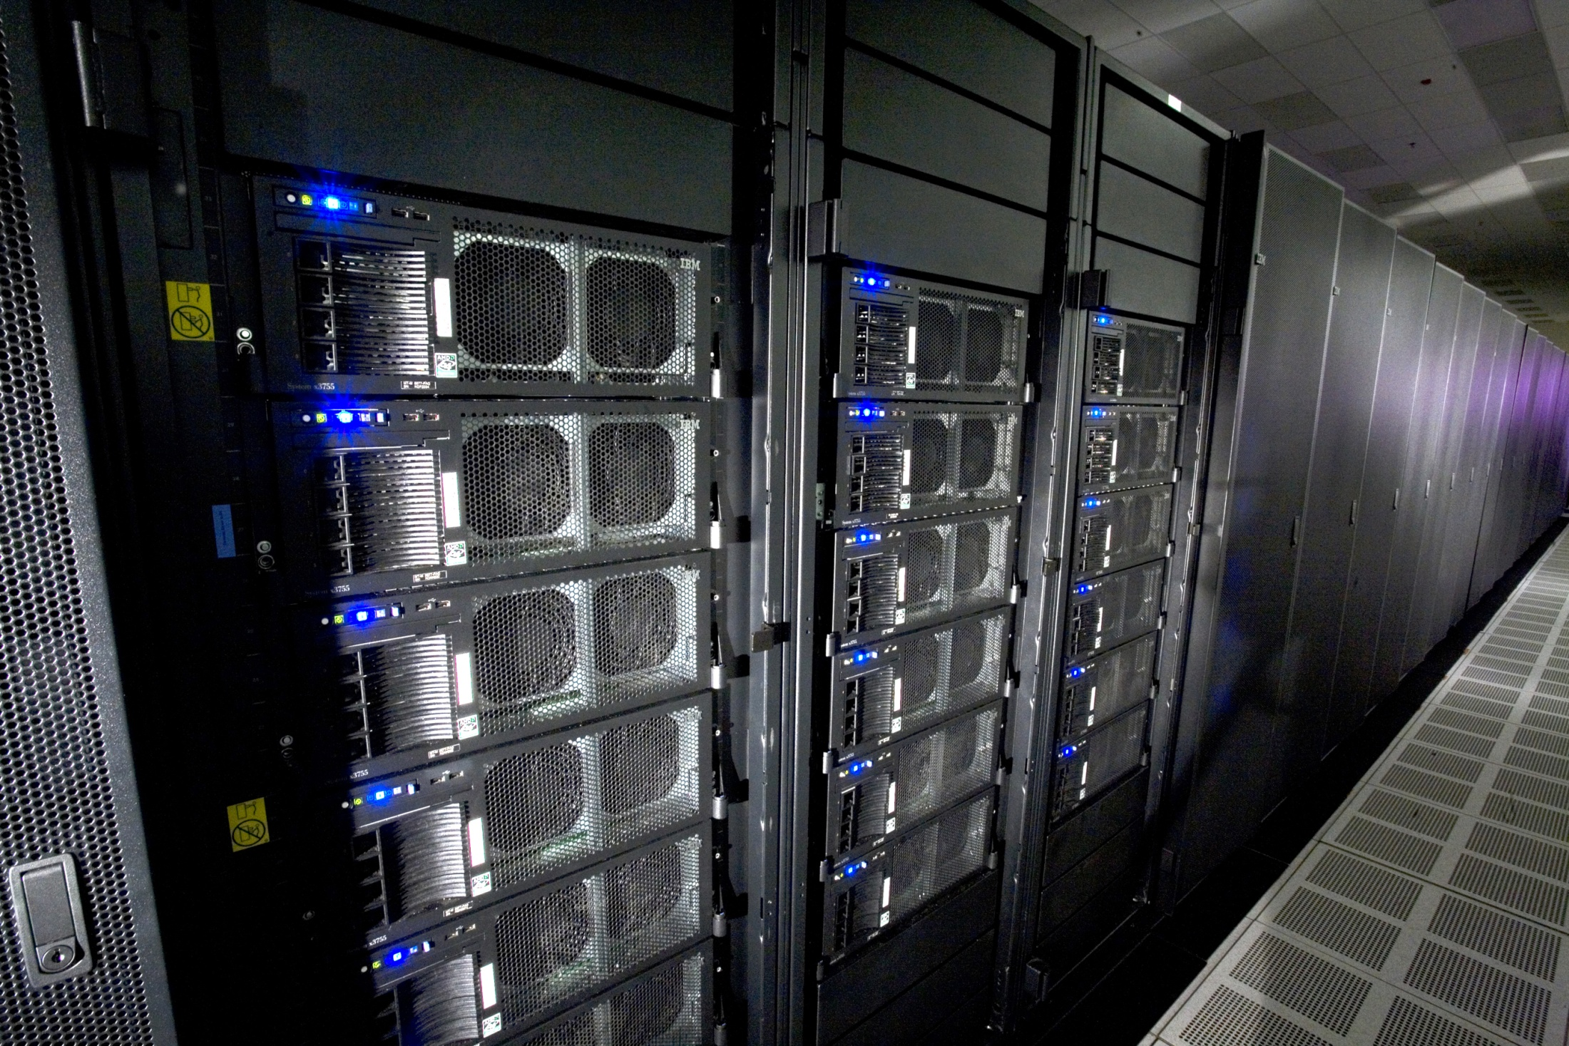
Source: Wikipedia (IBM Roadrunner)

Slide 29
Divide and Conquer
“Work”
Partition
w₁
w₂
w₃
“worker”
“worker”
“worker”
r₁
r₂
r₃
Combine
“Result”

Slide 30
Parallelization Challenges
How do we assign work units to workers?
What if we have more work units than workers?
What if workers need to share partial results?
How do we aggregate partial results?
How do we know all the workers have finished?
What if workers die?
What is the common theme of all of these problems?

Slide 31
Common Theme?
Parallelization problems arise from:
Communication between workers (e.g., to exchange state)
Access to shared resources (e.g., data)
Thus, we need a synchronization mechanism

Slide 32
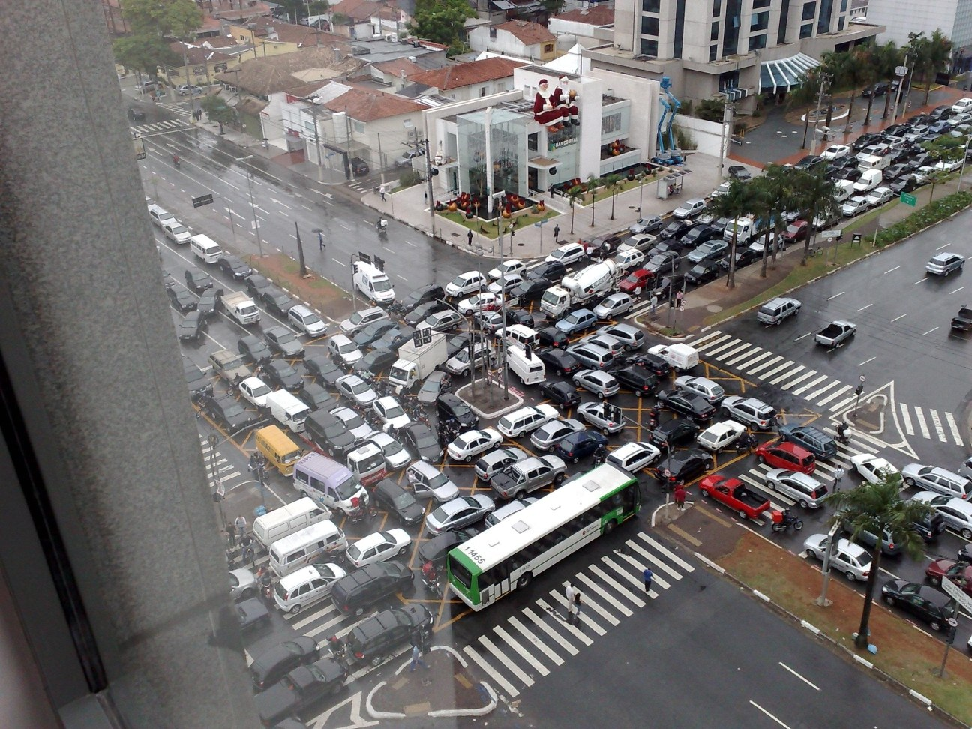
Source: Ricardo Guimarães Herrmann

Slide 33
Managing Multiple Workers
Difficult because
We don’t know the order in which workers run
We don’t know when workers interrupt each other
We don’t know the order in which workers access shared data
Thus, we need:
Semaphores (lock, unlock)
Conditional variables (wait, notify, broadcast)
Barriers
Still, lots of problems:
Deadlock, livelock, race conditions...
Dining philosophers, sleeping barbers, cigarette smokers...
Moral of the story: be careful!

Slide 34
Current Tools
Shared Memory
Message Passing
Programming models
Shared memory (pthreads)
Message passing (MPI)
Design Patterns
Master-slaves
Producer-consumer flows
Shared work queues
Memory
P₁
P₂
P₃
P₄
P₅
P₁
P₂
P₃
P₄
P₅
producer
consumer
master
work queue
slaves
producer
consumer

Slide 35
Where the rubber meets the road
Concurrency is difficult to reason about
Concurrency is even more difficult to reason about
At the scale of datacenters (even across datacenters)
In the presence of failures
In terms of multiple interacting services
Not to mention debugging…
The reality:
Lots of one-off solutions, custom code
Write you own dedicated library, then program with it
Burden on the programmer to explicitly manage everything

Slide 36

Source: Wikipedia (Flat Tire)

Slide 37
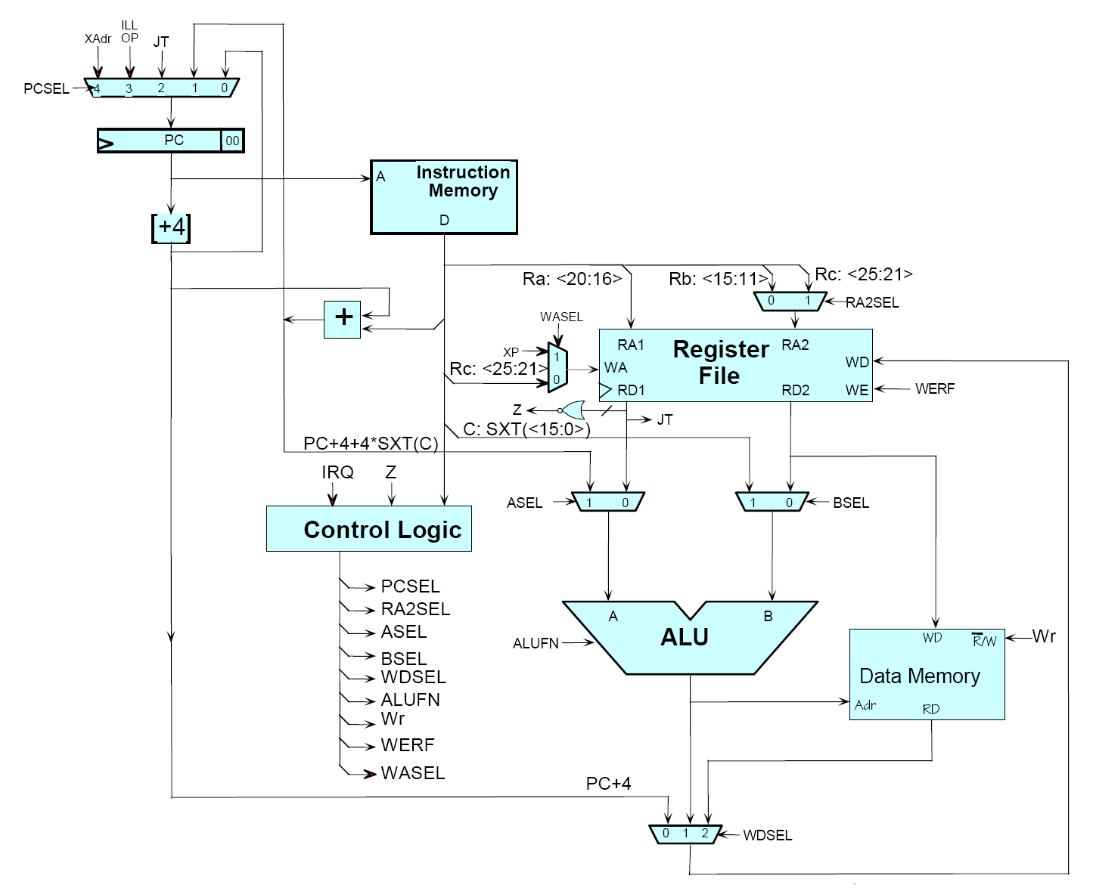
Source: MIT Open Courseware

Slide 38

Source: MIT Open Courseware

Slide 39
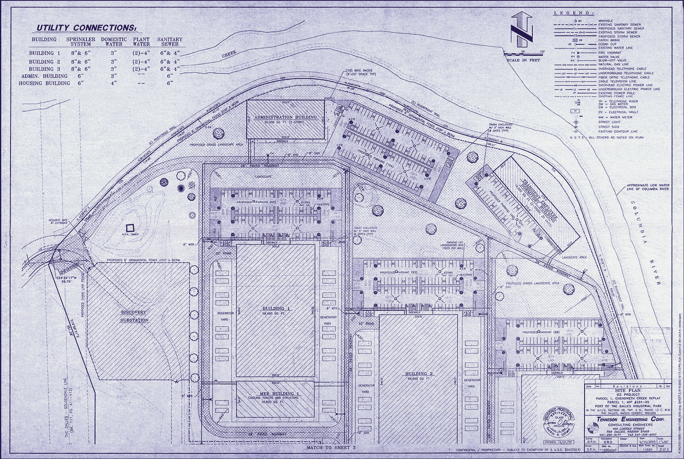
Source: Harper’s (Feb, 2008)

Slide 40
What’s the point?
It’s all about the right level of abstraction
The von Neumann architecture has served us well, but is no longer appropriate for the multi-core/cluster environment
Hide system-level details from the developers
No more race conditions, lock contention, etc.
Separating the what from how
Developer specifies the computation that needs to be performed
Execution framework (“runtime”) handles actual execution
The datacenter is the computer!

Slide 41
“Big Ideas”
Scale “out”, not “up”
Limits of SMP and large shared-memory machines
Move processing to the data
Cluster have limited bandwidth
Process data sequentially, avoid random access
Seeks are expensive, disk throughput is reasonable
Seamless scalability
From the mythical man-month to the tradable machine-hour

Slide 42
MapReduce

Slide 43
Typical Large-Data Problem
Iterate over a large number of records
Extract something of interest from each
Shuffle and sort intermediate results
Aggregate intermediate results
Generate final output
Map
Reduce
Key idea: provide a functional abstraction for these two operations
(Dean and Ghemawat, OSDI 2004)

Slide 44
Roots in Functional Programming
Map
f
f
f
f
f
Fold
g
g
g
g
g

Slide 45
MapReduce
Programmers specify two functions:
map (k, v) → <k’, v’>*
reduce (k’, v’) → <k’, v’>*
All values with the same key are sent to the same reducer
The execution framework handles everything else…

Slide 46
k₁
v₁
k₂
v₂
k₃
v₃
k₄
v₄
k₅
v₅
k₆
v₆
map
map
map
map
a
1
b
2
c
3
c
6
a
5
c
2
b
7
c
8
Shuffle and Sort: aggregate values by keys
a
1
5
b
2
7
c
2
3
6
8
reduce
reduce
reduce
r₁
s₁
r₂
s₂
r₃
s₃

Slide 47
MapReduce
Programmers specify two functions:
map (k, v) → <k’, v’>*
reduce (k’, v’) → <k’, v’>*
All values with the same key are sent to the same reducer
The execution framework handles everything else…
What’s “everything else”?

Slide 48
MapReduce “Runtime”
Handles scheduling
Assigns workers to map and reduce tasks
Handles “data distribution”
Moves processes to data
Handles synchronization
Gathers, sorts, and shuffles intermediate data
Handles errors and faults
Detects worker failures and restarts
Everything happens on top of a distributed FS (later)

Slide 49
MapReduce
Programmers specify two functions:
map (k, v) → <k’, v’>*
reduce (k’, v’) → <k’, v’>*
All values with the same key are reduced together
The execution framework handles everything else…
Not quite…usually, programmers also specify:
partition (k’, number of partitions) → partition for k’
Often a simple hash of the key, e.g., hash(k’) mod n
Divides up key space for parallel reduce operations
combine (k’, v’) → <k’, v’>*
Mini-reducers that run in memory after the map phase
Used as an optimization to reduce network traffic

Slide 50
k₁
v₁
k₂
v₂
k₃
v₃
k₄
v₄
k₅
v₅
k₆
v₆
map
map
map
map
a
1
b
2
c
3
c
6
a
5
c
2
b
7
c
8
combine
combine
combine
combine
a
1
b
2
c
9
a
5
c
2
b
7
c
8
partition
partition
partition
partition
Shuffle and Sort: aggregate values by keys
a
1
5
b
2
7
c
c
2
2
9
3
8
6
8
reduce
reduce
reduce
r₁
s₁
r₂
s₂
r₃
s₃

Slide 51
Two more details…
Barrier between map and reduce phases
But we can begin copying intermediate data earlier
Keys arrive at each reducer in sorted order
No enforced ordering across reducers

Slide 52
“Hello World”: Word Count
Map(String docid, String text):
for each word w in text:
Emit(w, 1);
Reduce(String term, Iterator<Int> values):
int sum = 0;
for each v in values:
sum += v;
Emit(term, value);

Slide 53
MapReduce can refer to…
The programming model
The execution framework (aka “runtime”)
The specific implementation
Usage is usually clear from context!

Slide 54
MapReduce Implementations
Google has a proprietary implementation in C++
Bindings in Java, Python
Hadoop is an open-source implementation in Java
Development led by Yahoo, used in production
Now an Apache project
Rapidly expanding software ecosystem
Lots of custom research implementations
For GPUs, cell processors, etc.

Slide 55
User Program
(1) submit
Master
(2) schedule map
(2) schedule reduce
worker
split 0
(6) write
output
file 0
split 1
(5) remote read
worker
split 2
(3) read
(4) local write
split 3
worker
split 4
worker
output
file 1
worker
Input
files
Map
phase
Intermediate files
(on local disk)
Reduce
phase
Output
files
Adapted from (Dean and Ghemawat, OSDI 2004)

Slide 56

How do we get data to the workers?
NAS
SAN
Compute Nodes
What’s the problem here?

Slide 57
Distributed File System
Don’t move data to workers… move workers to the data!
Store data on the local disks of nodes in the cluster
Start up the workers on the node that has the data local
Why?
Not enough RAM to hold all the data in memory
Disk access is slow, but disk throughput is reasonable
A distributed file system is the answer
GFS (Google File System) for Google’s MapReduce
HDFS (Hadoop Distributed File System) for Hadoop

Slide 58
GFS: Assumptions
Commodity hardware over “exotic” hardware
Scale “out”, not “up”
High component failure rates
Inexpensive commodity components fail all the time
“Modest” number of huge files
Multi-gigabyte files are common, if not encouraged
Files are write-once, mostly appended to
Perhaps concurrently
Large streaming reads over random access
High sustained throughput over low latency
GFS slides adapted from material by (Ghemawat et al., SOSP 2003)

Slide 59
GFS: Design Decisions
Files stored as chunks
Fixed size (64MB)
Reliability through replication
Each chunk replicated across 3+ chunkservers
Single master to coordinate access, keep metadata
Simple centralized management
No data caching
Little benefit due to large datasets, streaming reads
Simplify the API
Push some of the issues onto the client (e.g., data layout)
HDFS = GFS clone (same basic ideas)

Slide 60
From GFS to HDFS
Terminology differences:
GFS master = Hadoop namenode
GFS chunkservers = Hadoop datanodes
Functional differences:
No file appends in HDFS (planned feature)
HDFS performance is (likely) slower
For the most part, we’ll use the Hadoop terminology…

Slide 61
HDFS Architecture
HDFS namenode
Application
/foo/bar
(file name, block id)
File namespace
HDFS Client
block 3df2
(block id, block location)
instructions to datanode
(block id, byte range)
datanode state
HDFS datanode
HDFS datanode
block data
Linux file system
Linux file system
…
…
Adapted from (Ghemawat et al., SOSP 2003)

Slide 62
Namenode Responsibilities
Managing the file system namespace:
Holds file/directory structure, metadata, file-to-block mapping, access permissions, etc.
Coordinating file operations:
Directs clients to datanodes for reads and writes
No data is moved through the namenode
Maintaining overall health:
Periodic communication with the datanodes
Block re-replication and rebalancing
Garbage collection

Slide 63
Putting everything together…
namenode
job submission node
namenode daemon
jobtracker
tasktracker
tasktracker
tasktracker
datanode daemon
datanode daemon
datanode daemon
Linux file system
Linux file system
Linux file system
…
…
…
slave node
slave node
slave node

Slide 64
Recap
Why large data?
Cloud computing and MapReduce
Large-data processing: “big ideas”
What is MapReduce?
Importance of the underlying distributed file system

Slide 65

Questions?
Photo credit: Jimmy Lin

